Slide 1

Hollister ranch – coastal access program planning update
CALIFORNIA COASTAL COMMISSION
STATEWIDE COASTAL ACCESS PROGRAM Item W6c 11.4.20 Slide 1

Slide 2
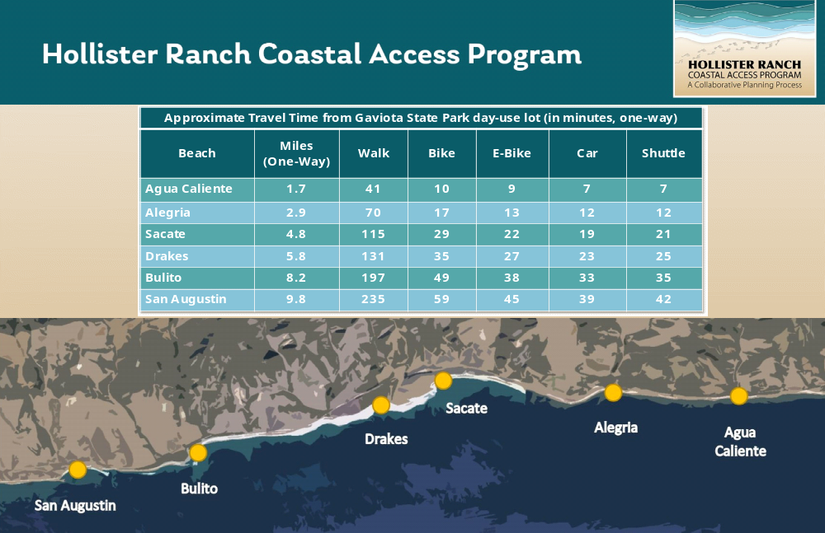
CALIFORNIA COASTAL COMMISSION
STATEWIDE COASTAL ACCESS PROGRAM Item W6c 11.4.20 Slide 2

Slide 3
CCC website for background resources: https://www.coastal.ca.gov/ hollister-ranch/
E mail to:
HRCAP.Stakeholders@gmail. com
CALIFORNIA COASTAL COMMISSION
STATEWIDE COASTAL ACCESS PROGRAM Item W6c 11.4.20 Slide 3

